Slide 1

Hybrid Models (and more!)
Lynette H. Bikos, PhD, ABPP

Slide 2

The big goals for today:
Create an CFA measurement model.
1
This CFA measurement model is one of the important products from a psychometrically sound instrument (i.e., the work we have been doing throughout this OER)
Respecify it as an SEM structural model.
2
Do this with real, raw data, that needs
3
Downloading/importing
Cleaning
Management of missingness
Data diagnostics

Slide 3

What is a measurement model?
A confirmatory factor analytic model (i.e., latent variables and their indicators)
More complex than the a priorili theorized structural model
Comparing the two, the measurement will have the best fit
Which means, if your measurement model stinks, your structural model will be worse

Slide 4
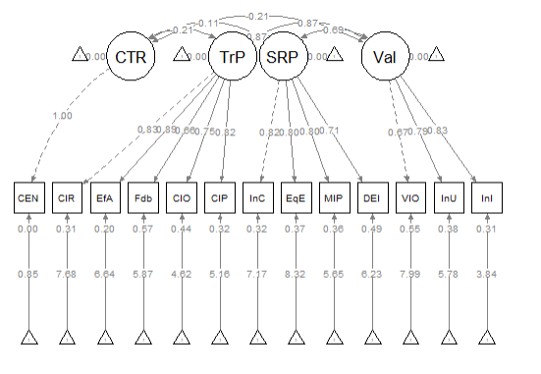
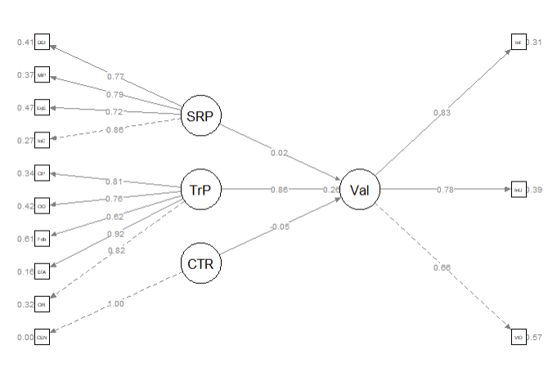
Let’s take a look:
Measurement Model
Structural Model

Slide 5
Why do we need to go to all this trouble (when we could save time and effort with OLS regression)?
SEM allows us to specify and evaluate complex models with multiple dependent and independent variables, latent variables, as well as direct and indirect effects.
SEM can explicitly model measurement error and latent variables (i.e., unobserved constructs that underlie observed variables). OLS regression does not account for measurement error unless they are explicitly included as observed variables in the model.
SEM offers global fit indices (e.g., Chi-square, CFI, RMSEA, SRMR) as well as the local fit indices (i.e., the regression weights/parameters of interest).
SEM can handle missing data, allowing us to retain cases with some missingness.

Slide 6
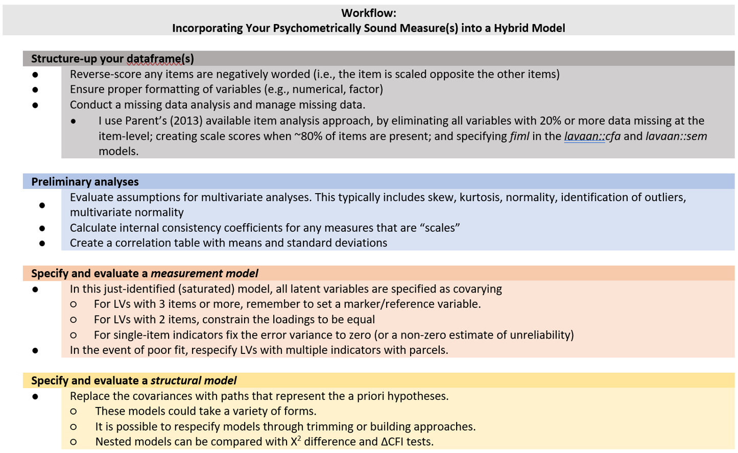

Slide 7
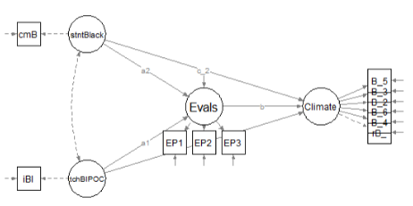
Today’s research vignette
Comes from the open survey: Rate-a-Recent Course: A ReCentering Psych Stats Exercise
Go take it if you haven’t!
Our a priorili defined SEM is a parallel mediation predicting perceptions of campus climate for students who are Black from
the percent of classmates who are Black,
the proportion of instructional staff who are BIPOC,
course evaluation ratings that assess the degree to which the pedagogy is socially responsive

Slide 8

Should I panic if I don’t know anything about mediation?

Slide 9

The second goal of the lesson
Is a big one.
This .rmd file is gnarly as we work a problem from raw data, through scrubbing, scoring, and data diagnostics.
Why?
Because as you approach empirical research projects it’s important to see this process and have a mental model (as well as skeletal .rmd code) to get started.
In my own classes, this lecture (the last in the series on psychometrics) provides a cognitive organizer for the multivariate class that follows.

Slide 10
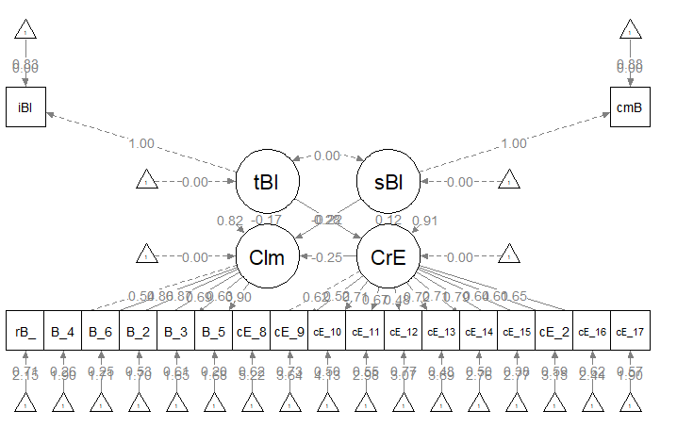
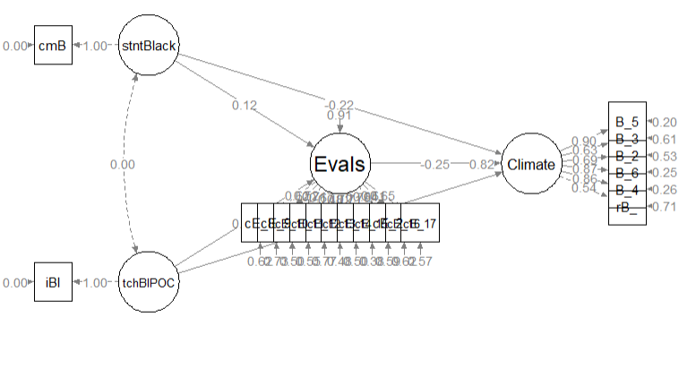
Comparing measurement and structural models
Measurement
Structural

Slide 11

Model Identification
SEM models must have df ≥ 0
For CFA models (i.e., the “measurement” part) to be identified:
Unidimensional models require ≥ 3 indicators per LV
Multidimensional models require ≥ 2 indicators per LV
Second order structures need ≥ 3 first order factors
There are ways to get around this…but those are the rules of thumb

Slide 12
Levels of identification
Underidentified (aka undetermined) models have fewer observations (knowns) than free model parameters (unknowns)
Negative degrees of freedom
Just-identified (aka just-determined) models have an equal number of knowns and unknowns
Zero degrees of freedom
Overidentified models have more knowns than unknowns
Positive degrees of freedom

Slide 13
We check model identification at two levels
Overall model
Knowns : n(n + 1)/2)
19 observed variables
19(19+1)/2 = 190 knowns
Unknowns
17 measurement regression paths (excludes marker variables or single-indicator items)
5 structural regression paths
17 error covariances
2 residual error variances
0 covariances
Total: 41
190 (knowns) – 41(unknowns) = 149
We are overidentified (yay!)
This should be the df in the chi-square test for the model

Slide 14
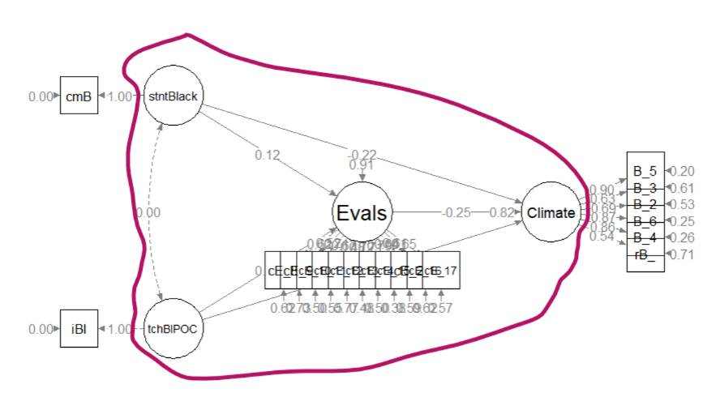
Assessing model identification for the structural portion of the model
We can have an overidentified overall model, but we need to be at df ≥ 0 in the structural portion of the model
Knowns: k(k+1)/2; where k = LV
4(4+1)/2 = 10
Unknowns:
Exogenous (predictor) variables: 2
Endogenous (predicted) variables: 2
Correlations: 0
Regression paths: 5
Knowns = 9
df = 10-9, we are overidentified with +1df

